Slide 1
Bank analytics
Group 2

Slide 2
Team members
Disha shrawan thakre
Rizwan maqool ansari
Niharika Panda
Yash Chaudhary
Ravali nampalli

Slide 3
Tools & Technologies used
Excel
Sql
Tableau
PowerPoint

Slide 4
Introduction:
Banking analytics refers to the application of data analytics ,that is the
use of various tools and technologies to collect ,process and analyze
raw data within the banking industry.
Examples :Banking analytics include customer segmentation ,credit
risk management and fraud detection.

Slide 5
KPI’s
Year wise loan amount Stats
Grade and subgrade wise revol_bal
Total Payment for Verified Status Vs Total Payment for Non Verified Status
State wise and last_credit_pull_d wise loan status
Home ownership Vs last payment date stats

Slide 6
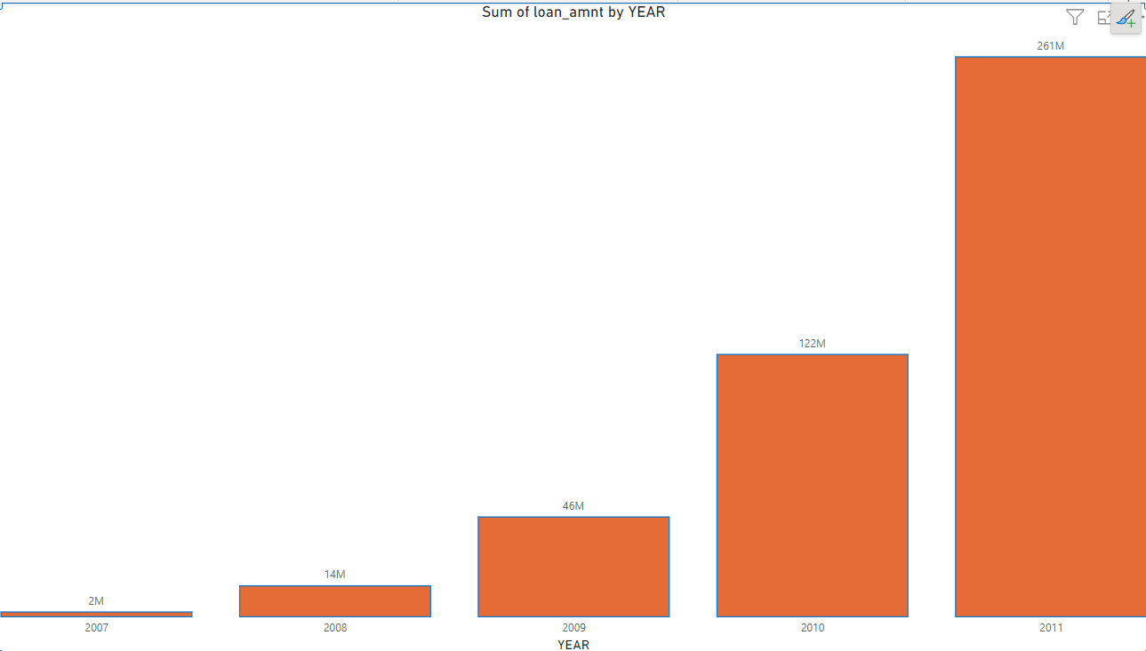
Year wise loan amount stats
In 2011 had the highest sum of loan amount.
Across all 5 years sum of loan amount ranged from 2M to 26M.
2011 year accounted for 58.46% sum of loan amount.

Slide 7
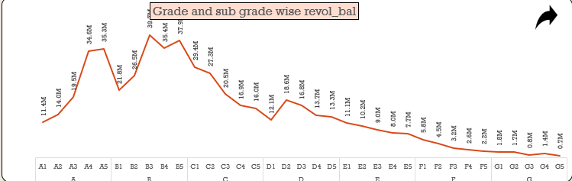
Grade and subgrade wise revol balance
In this kpi revol balance is high when it is in grade B with the amount of 39M.
Revol balance is low when grade G.

Slide 8
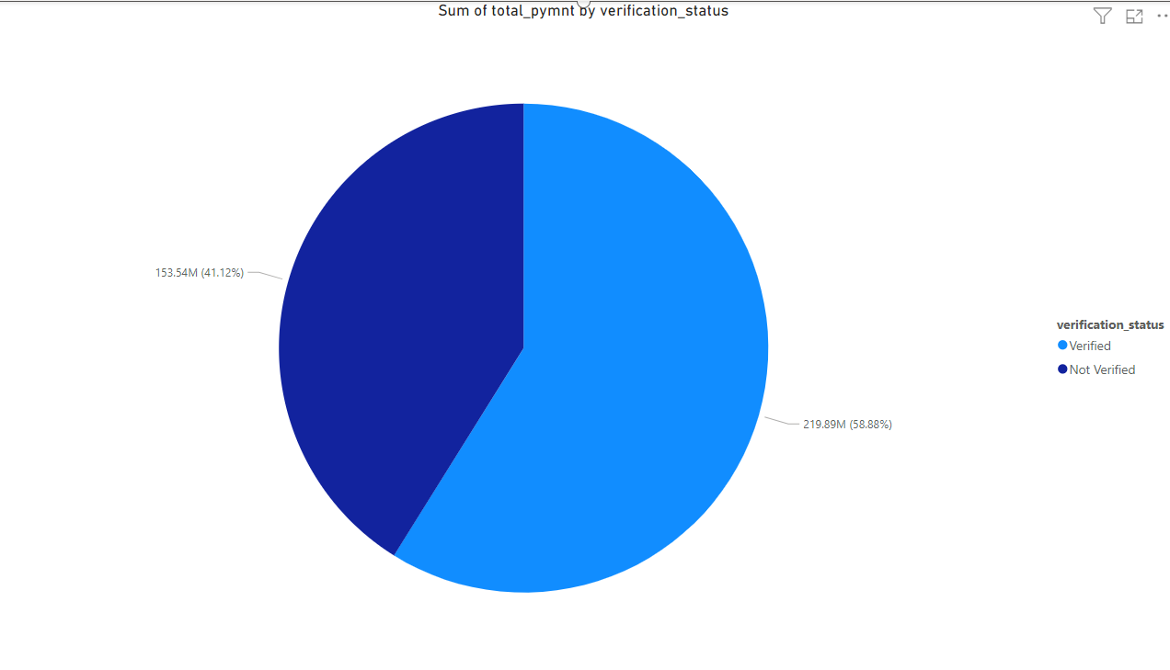
Total payment for verified status vs non -verified status
Sum of total payment for verified status 58.88% and non verified status is 42.12%.so that ,Sum of total payment for verified status is higher than non-verified status

Slide 9
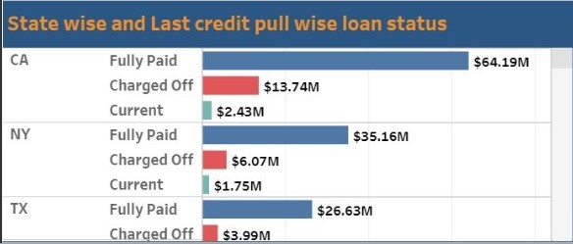
State wise and last credit pull day wise loan status
In this kpi loan status for fully paid in every state is higher than all the loan status.
State CA of last credit pull day wise is fully paid accounted for $64.19M.

Slide 10
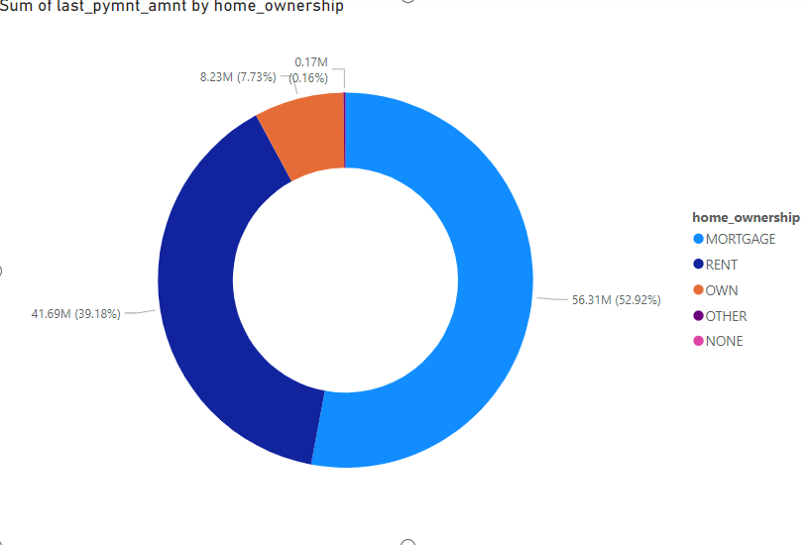
Home ownership vs last payment date stats
Home ownership vs last payment date stats are mortgage accounted for 52.92 % ,rent accounted for 39.18% ,own for 7.73% .
Among all these mortgage accounted for 56.31 M which is very high.

Slide 11
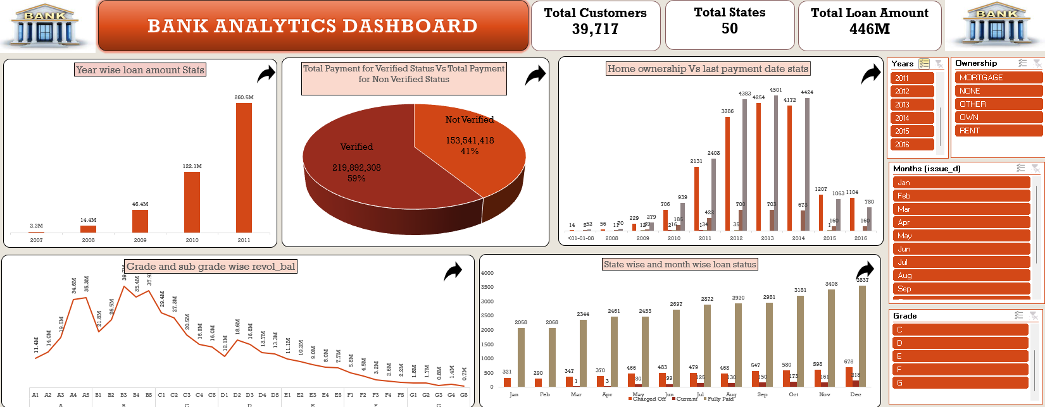
Excel dashboard

Slide 12
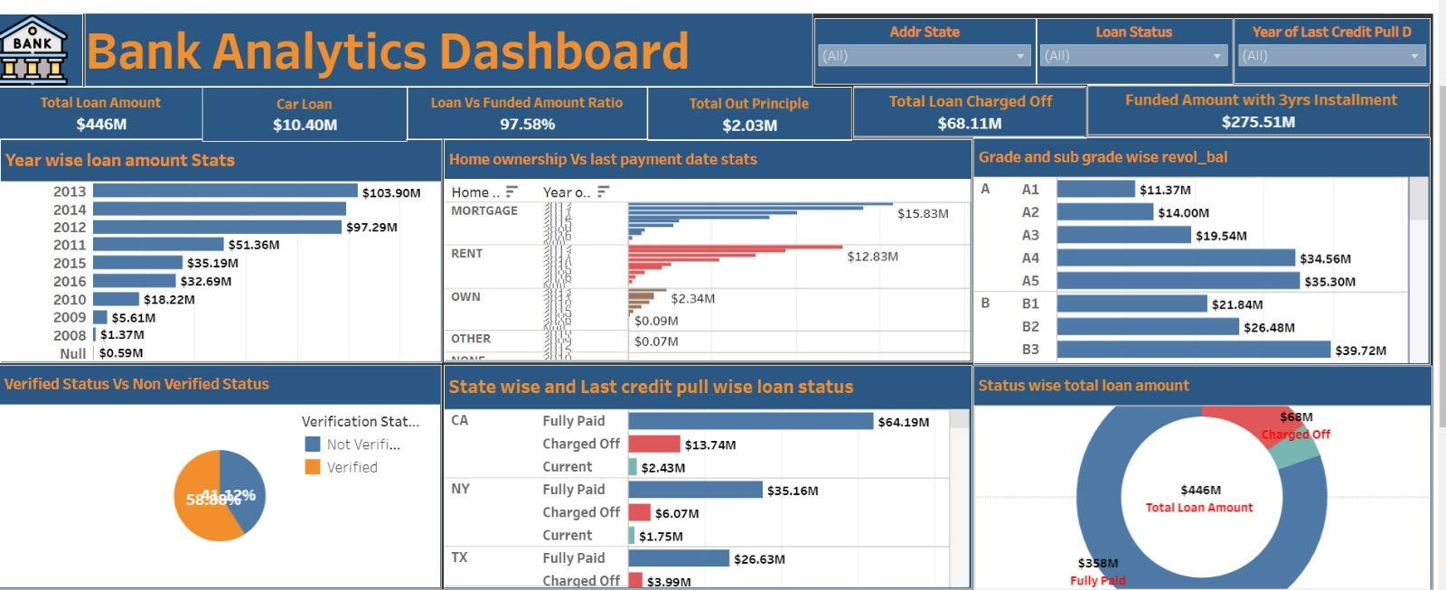
Tableau Dashboard

Slide 13
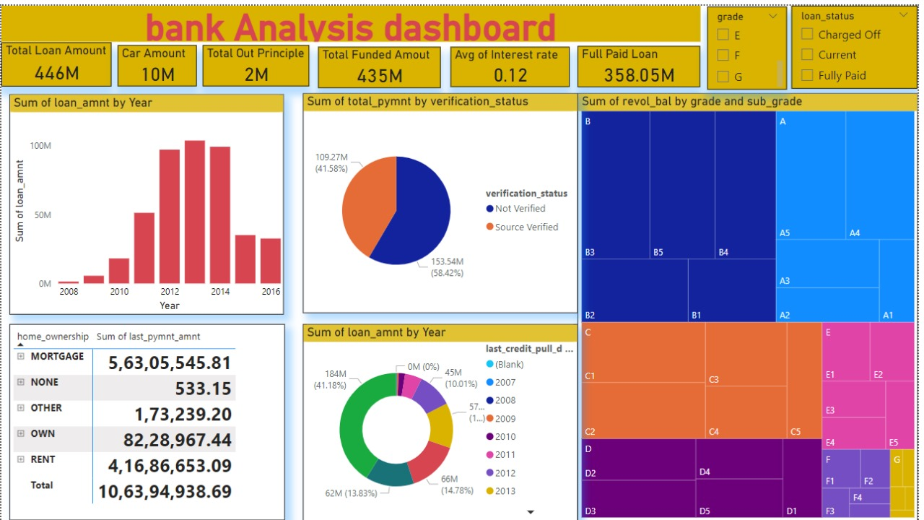
PowerBi dashboard

Slide 14
Recommendations:
Regularly monitor and analyse the daily customer reviews to gain profits in this banking sector.
Promote financial literacy through customer education.
Provide customers with self service opportunities.

Slide 15
Thank you!

